Slide 1
CS246: Query-Likelihood Probabilistic Model
Junghoo “John” Cho
UCLA
(Some slides are based on ChenXiang Zhai’s UIUC class)

Slide 2

Probabilistic Model
Probabilistic ranking model: rank document by $Pr⁡(R(d)=1|q)$
  $R:$ binary “relevance indicator” variable. 1 if relevant 0 if not.
  Given query $q$, what is the probability document $d$ is relevant?
Q: How do we get $Pr⁡(R(d)=1|q)$?

Slide 3
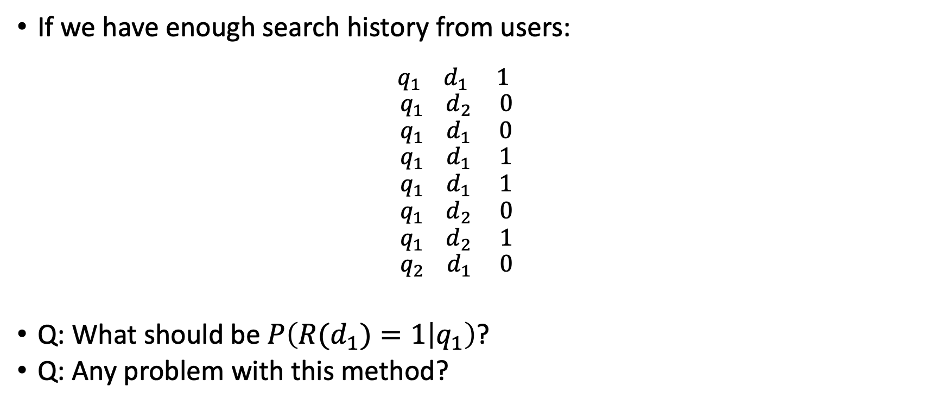

Estimating $P(R(d)=1|q)$
If we have enough search history from users:
  $$q_{1} d_{1} 1$$
  $$q_{1} d_{2} 0$$
  $$q_{1} d_{1} 0$$
  $$q_{1} d_{1} 1$$
  $$q_{1} d_{1} 1$$
  $$q_{1} d_{2} 0$$
  $$q_{1} d_{2} 1$$
  $$q_{2} d_{1} 0$$
Q: What should be $P\left(R(d_{1})=1 | q_{1}\right)$?
Q: Any problem with this method?

Slide 4

Estimating $P(R(d)=1|q)$
Q: How can estimate $Pr⁡(R(d)=1|q)$ for $q$and $d$for which we don’t have much data?
  What assumptions can we make to calculate this probability?
Q: How do users decide if a page is relevant to a query?

Slide 5
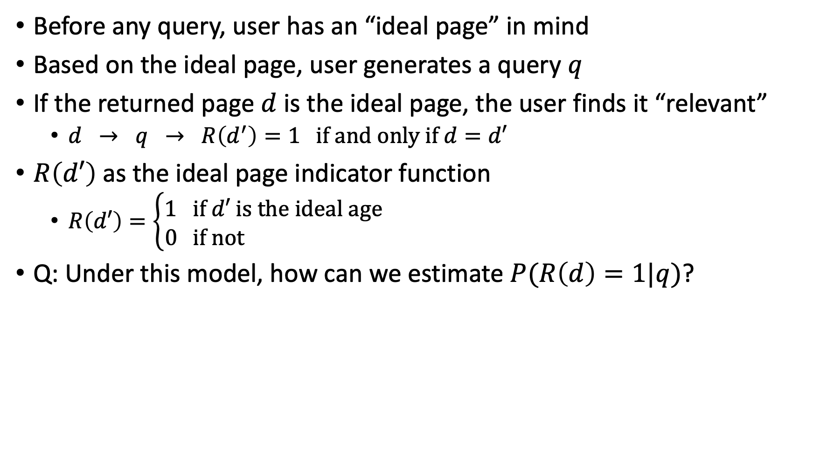
“Ideal Page” behind a Query Model
Before any query, user has an “ideal page” in mind
Based on the ideal page, user generates a query $q$
If the returned page $d$ is the ideal page, the user finds it “relevant”
  $d → q → R\left(d^{′}\right)=1 if and only if d=d′$
$R\left(d′\right)$as the ideal page indicator function
  $R\left(d′\right)=\left\{\begin{matrix}1 if d′ is the ideal age \\ 0 if not \end{matrix}\right.$
Q: Under this model, how can we estimate $P(R\left(d\right)=1|q)$?

Slide 6
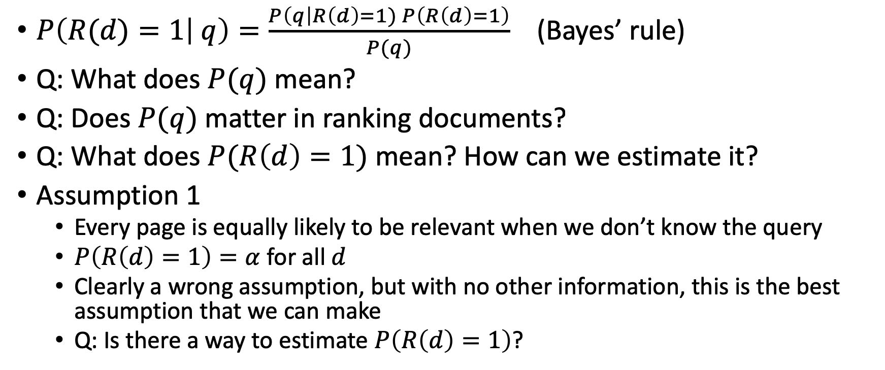
Query-Likelihood Probabilistic Model
$P\left(R(d)=1 | q\right)=\frac{P\left(q\right|R\left(d\right)=1) P\left(R\left(d\right)=1\right)}{P(q)}$ (Bayes’ rule)
Q: What does $P(q)$mean?
Q: Does $P(q)$ matter in ranking documents?
Q: What does $P(R\left(d\right)=1)$ mean? How can we estimate it?
Assumption 1
  Every page is equally likely to be relevant when we don’t know the query
  $P\left(R\left(d\right)=1\right)=α$ for all $d$
  Clearly a wrong assumption, but with no other information, this is the best assumption that we can make
  Q: Is there a way to estimate $P\left(R\left(d\right)=1\right)$?

Slide 7
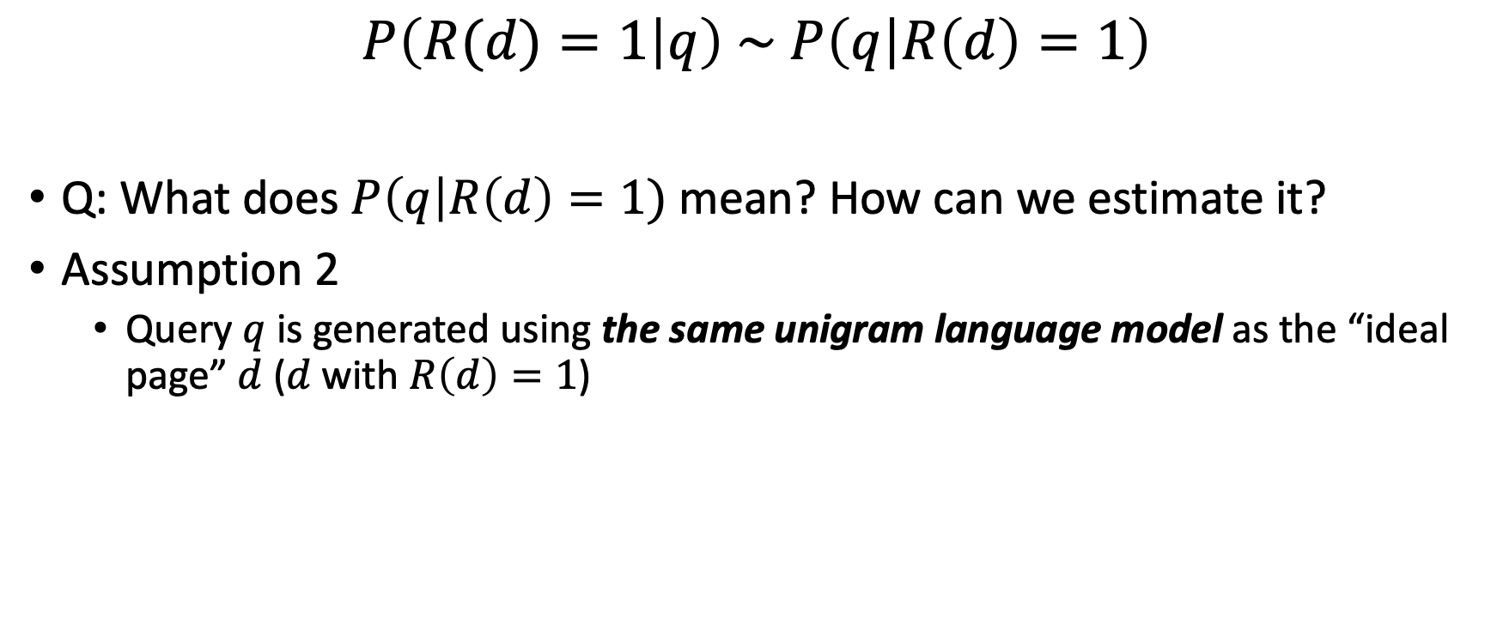
Query-Likelihood Probabilistic Model
$$P\left(R(d)=1 | q\right) \sim P\left(q | R\left(d\right)=1\right)$$
Q: What does $P\left(q\right|R\left(d\right)=1)$mean? How can we estimate it?
Assumption 2
  Query $q$ is generated using the same unigram language model as the “ideal page” $d$ ($d$with $R\left(d\right)=1$)

Slide 8

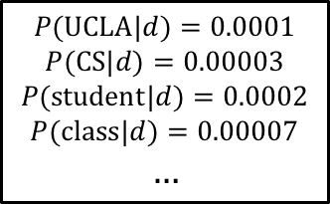
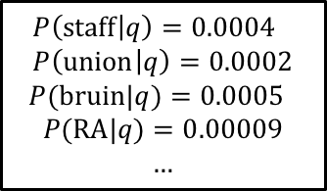
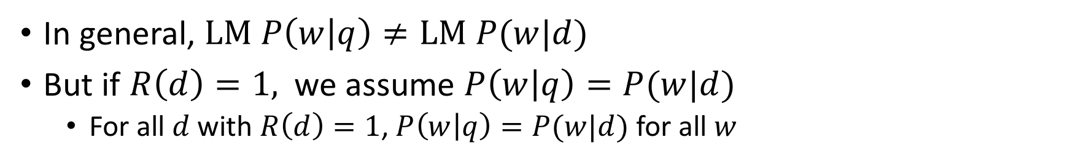





Equivalence of Unigram Language Model
$$LM(d)$$
$$P(UCLA|d)=0.0001$$
$$P(CS|d)=0.00003$$
$$P(student|d)=0.0002$$
$$P(class|d)=0.00007$$
$$…$$
$$d=w_{1}…w_{n}$$
….. UCLA … school …
.. staff … bruin …
$$P\left(d\right)=P(w_{1}|d)…{P(w}_{n}|d)$$
$$LM(q)$$
$$P\left(staff | q\right)=0.0004 \\ P\left(union | q\right)=0.0002$$
$P(bruin|q)=0.0005$
$$P(RA|q)=0.00009$$
$$…$$
$$q=w_{1}…w_{m}$$
bruin bear
$$P\left(q\right)=P(w_{1}|q)…{P(w}_{m}|q)$$
In general, $LM P\left(w | q\right)≠LM P(w|d)$
But if $R\left(d\right)=1,$ we assume $P\left(w | q\right)=P(w|d)$
  For all $d$ with $R\left(d\right)=1$, $P\left(w | q\right)=P(w|d)$ for all $w$

Slide 9
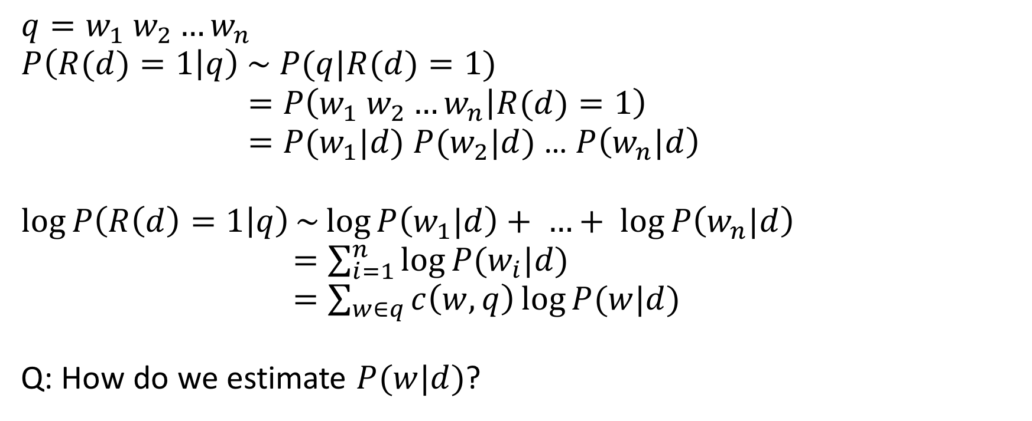
Ranking in Unigram Query-Likelihood Model
$$q=w_{1} w_{2}…w_{n}$$
$$P\left(R(d)=1 | q\right) \sim P(q|R(d)=1)$$
$$=P\left(w_{1} w_{2}…w_{n} | R(d)=1\right)$$
$=P(w_{1}|d)$ $P(w_{2}|d)$ … $P\left(w_{n}|d\right)$
$$\log{P\left(R\left(d\right)=1 | q\right)}\sim \log{P\left(w_{1}|d\right)}+ …+ \log{P\left(w_{n}|d\right)}$$
$=\sum_{i=1}^{n}{\log{P(w_{i}|d)}}$
$=\sum_{w∈q}{c\left(w,q\right)\log{P(w|d)}}$
Q: How do we estimate $P(w|d)$?

Slide 10
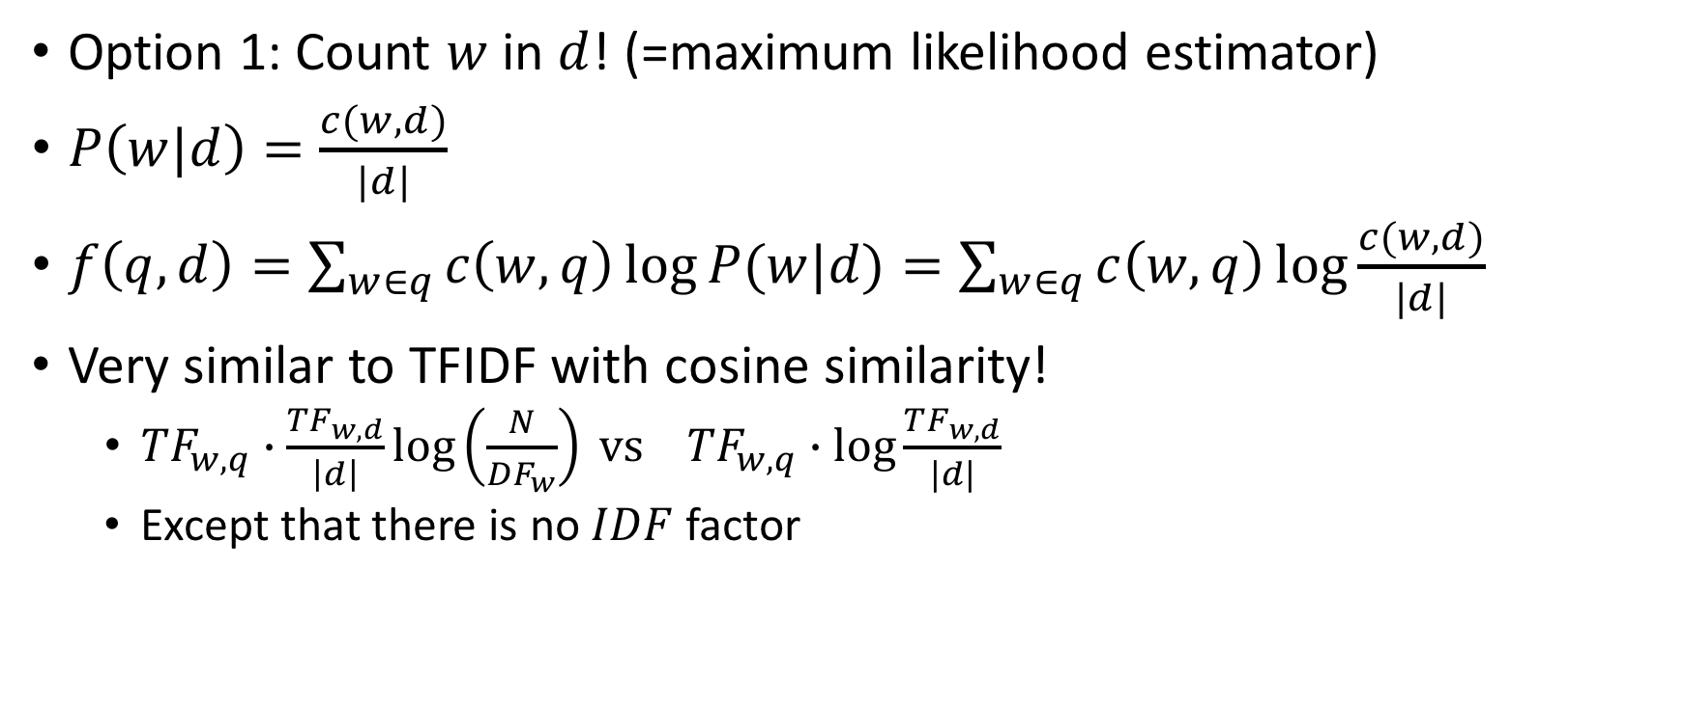

Estimating $P(w|d)$
Option 1: Count $w$ in $d$! (=maximum likelihood estimator)
$P\left(w|d\right)=\frac{c(w,d)}{|d|}$
$f\left(q,d\right)=\sum_{w∈q}{c\left(w,q\right)\log{P(w|d)}}=\sum_{w∈q}{c\left(w,q\right)\log{\frac{c(w,d)}{|d|}}}$
Very similar to TFIDF with cosine similarity!
  $TF_{w,q}∙\frac{TF_{w,d}}{\left|d\right|}\log\left(\frac{N}{DF_{w}}\right) vs TF_{w,q}∙\log{\frac{TF_{w,d}}{|d|}}$
  Except that there is no $IDF$ factor

Slide 11
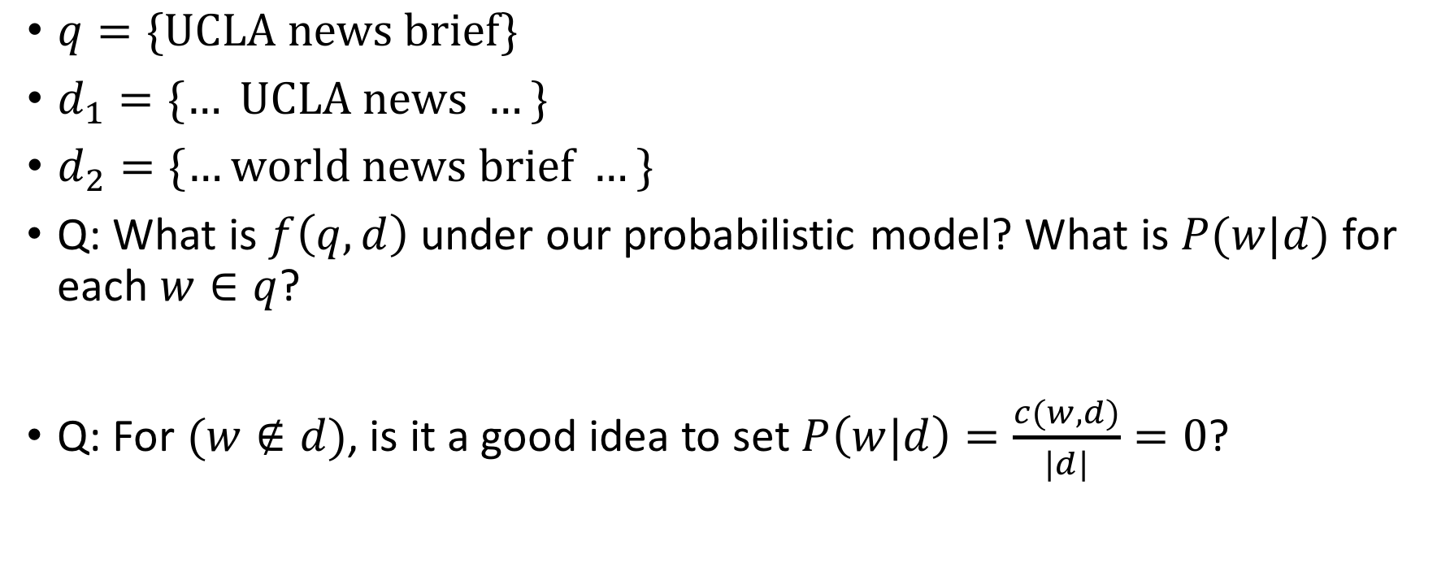
Overfitting Problem
$q=\{UCLA news brief\}$
$d_{1}=\{… UCLA news …\}$
$d_{2}=\{…world news brief …\}$
Q: What is $f\left(q,d\right)$ under our probabilistic model? What is $P(w|d)$ for each $w∈q$?
Q: For $(w∉d)$, is it a good idea to set $P\left(w|d\right)=\frac{c(w,d)}{|d|}=0$?

Slide 12


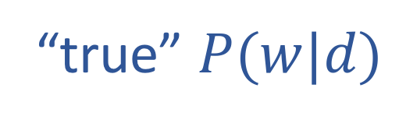
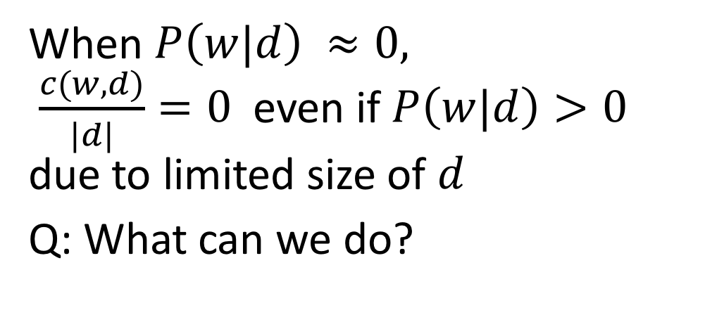
Estimation: $P\left(w|d\right)=\frac{c(w,d)}{|d|}$
“true” $P(w|d)$
When $P\left(w|d\right) ≈0,$
$\frac{c(w,d)}{|d|}=0$ even if $P\left(w|d\right)>0$
due to limited size of $d$
Q: What can we do?
$$\frac{c(w,d)}{|d|}$$

Slide 13
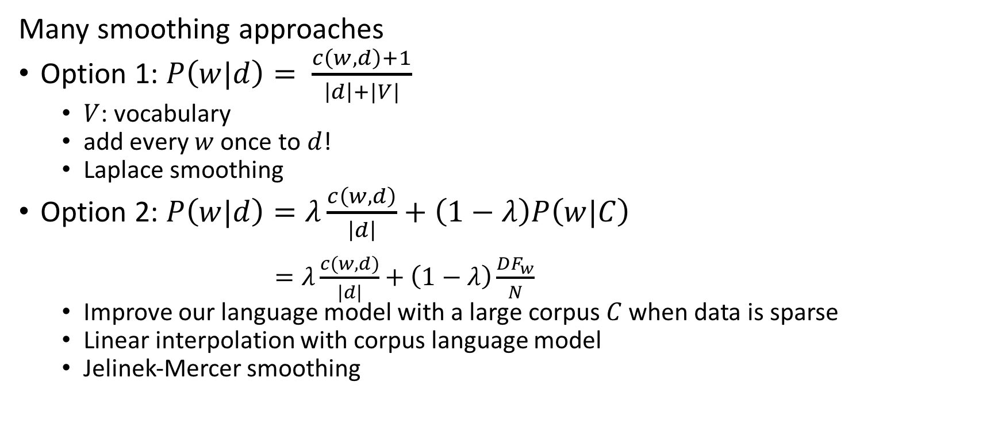

Estimation of $P\left(w|d\right)$: Smoothing
Many smoothing approaches
Option 1: $P\left(w|d\right)= \frac{c\left(w,d\right)+1}{\left|d\right|+|V|}$
  $V$: vocabulary
  add every $w$once to $d$!
  Laplace smoothing
Option 2: $P\left(w|d\right)=λ\frac{c\left(w,d\right)}{\left|d\right|}+\left(1−λ\right)P\left(w|C\right)$
$=λ\frac{c\left(w,d\right)}{\left|d\right|}+\left(1−λ\right)\frac{DF_{w}}{N}$
  Improve our language model with a large corpus $C$ when data is sparse
  Linear interpolation with corpus language model
  Jelinek-Mercer smoothing

Slide 14
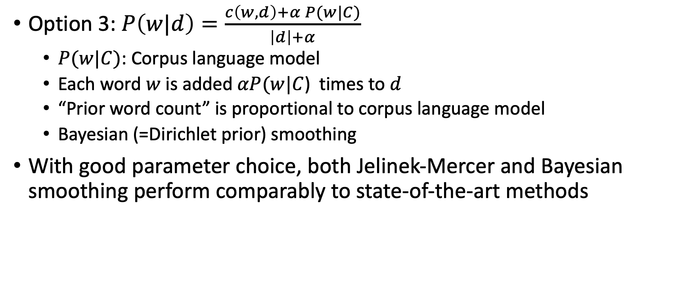
Estimation of $P\left(w|d\right)$: Smoothing
Option 3: $P\left(w|d\right)=\frac{c\left(w,d\right)+α P(w|C)}{\left|d\right|+α}$
  $P(w|C)$: Corpus language model
  Each word $w$ is added$αP(w|C$) times to $d$
  “Prior word count” is proportional to corpus language model
  Bayesian (=Dirichlet prior) smoothing
With good parameter choice, both Jelinek-Mercer and Bayesian smoothing perform comparably to state-of-the-art methods

Slide 15

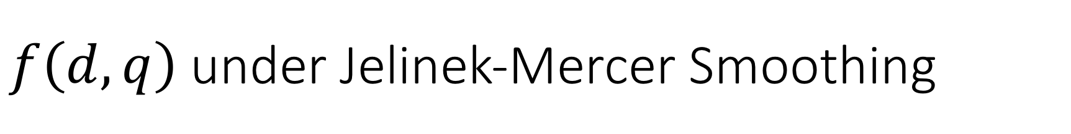
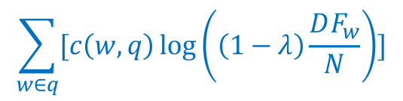
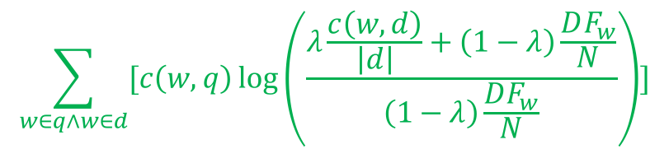
$f\left(d,q\right)$under Jelinek-Mercer Smoothing
$$f\left(q,d\right)$$
=$\sum_{w∈q}{[c\left(w,q\right)\log{P(w|d)]}}$
= $\sum_{w∈q∧w∈d}{[c\left(w,q\right)\log{P(w|d)]}}$ + $\sum_{w∈q∧w∉d}{[c\left(w,q\right)\log{P(w|d)]}}$
= $\sum_{w∈q∧w∈d}{[c\left(w,q\right)\log\left(λ\frac{c\left(w,d\right)}{\left|d\right|}+\left(1−λ\right)\frac{DF_{w}}{N}\right)]}$
$−\sum_{w∈q∧w∈ d}{[c\left(w,q\right)\log\left(\left(1−λ\right)\frac{DF_{w}}{N}\right)]}$
$+\sum_{w∈q∧w∉d}{[c\left(w,q\right)\log\left(\left(1−λ\right)\frac{DF_{w}}{N}\right)]}$
$+\sum_{w∈q∧w∈ d}{[c\left(w,q\right)\log\left(\left(1−λ\right)\frac{DF_{w}}{N}\right)]}$
$$\sum_{w∈q∧w∈d}{[c\left(w,q\right)\log\left(\frac{λ\frac{c\left(w,d\right)}{\left|d\right|}+\left(1−λ\right)\frac{DF_{w}}{N}}{\left(1−λ\right)\frac{DF_{w}}{N}}\right)]}$$
$$\sum_{w∈q}{[c\left(w,q\right)\log\left(\left(1−λ\right)\frac{DF_{w}}{N}\right)]}$$

Slide 16
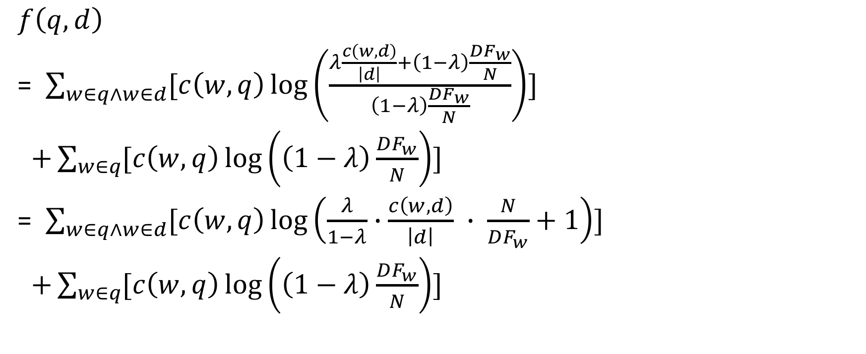

$f\left(d,q\right)$under Jelinek-Mercer Smoothing
$$f\left(q,d\right)$$
= $\sum_{w∈q∧w∈d}{[c\left(w,q\right)\log\left(\frac{λ\frac{c\left(w,d\right)}{\left|d\right|}+\left(1−λ\right)\frac{DF_{w}}{N}}{\left(1−λ\right)\frac{DF_{w}}{N}}\right)]}$
$+\sum_{w∈q}{[c\left(w,q\right)\log\left(\left(1−λ\right)\frac{DF_{w}}{N}\right)]}$
= $\sum_{w∈q∧w∈d}{[c\left(w,q\right)\log\left(\frac{λ}{1−λ}∙\frac{c\left(w,d\right)}{\left|d\right|} ∙ \frac{N}{DF_{w}}+1\right)]}$
$+\sum_{w∈q}{[c\left(w,q\right)\log\left(\left(1−λ\right)\frac{DF_{w}}{N}\right)]}$
Is this term dependent on $d$?

Slide 17
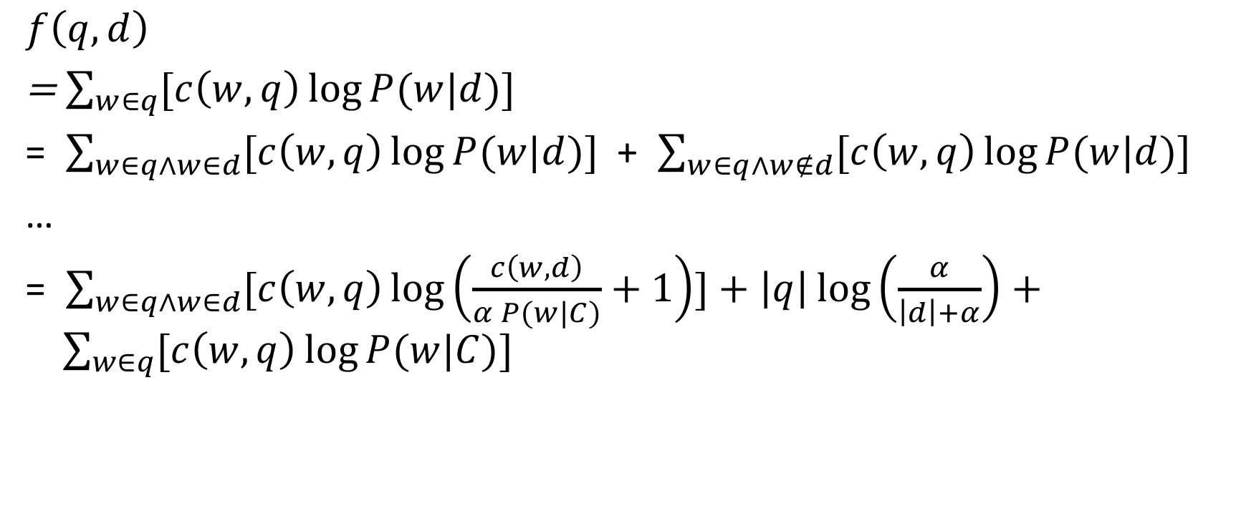
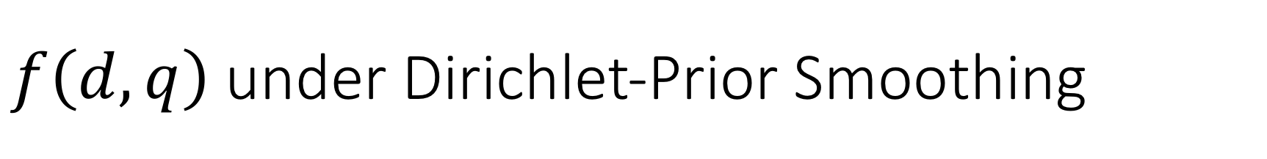
$f\left(d,q\right)$under Dirichlet-Prior Smoothing
$$f\left(q,d\right)$$
=$\sum_{w∈q}{[c\left(w,q\right)\log{P(w|d)]}}$
= $\sum_{w∈q∧w∈d}{[c\left(w,q\right)\log{P(w|d)]}}$ + $\sum_{w∈q∧w∉d}{[c\left(w,q\right)\log{P(w|d)]}}$
…
= $\sum_{w∈q∧w∈d}{[c\left(w,q\right)\log\left(\frac{c\left(w,d\right)}{α P(w|C)}+1\right)]}+\left|q\right|\log\left(\frac{α}{\left|d\right|+α}\right)+ \sum_{w∈q}{[c\left(w,q\right)\log{P(w|C)}]}$

Slide 18
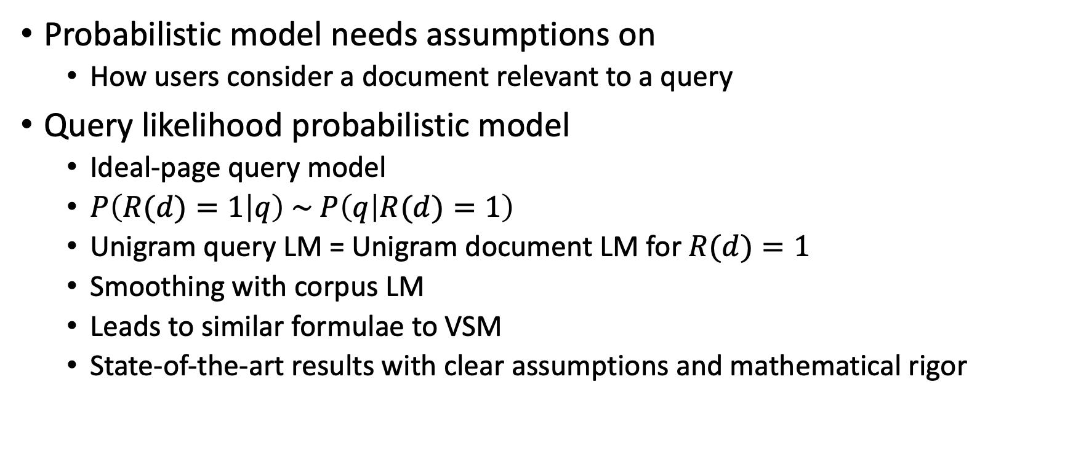
Summary
Probabilistic model needs assumptions on
  How users consider a document relevant to a query
Query likelihood probabilistic model
  Ideal-page query model
  $P\left(R(d)=1 | q\right) \sim P\left(q | R(d)=1\right)$
  Unigram query LM = Unigram document LM for $R(d)=1$
  Smoothing with corpus LM
  Leads to similar formulae to VSM
  State-of-the-art results with clear assumptions and mathematical rigor

